Slide 1
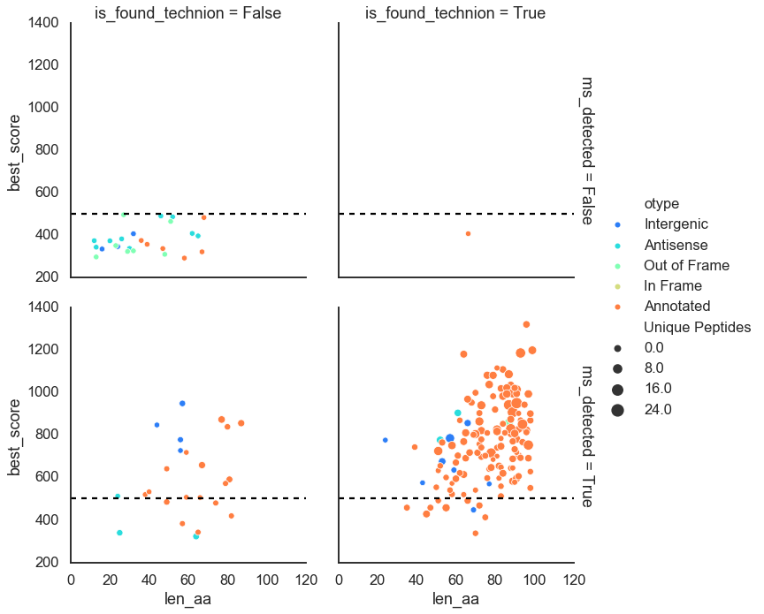
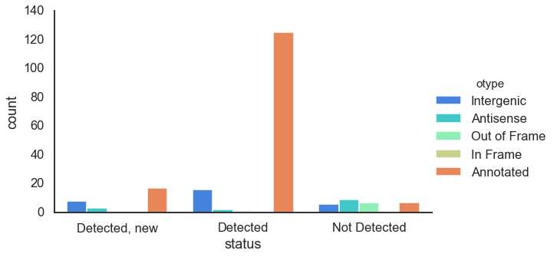
Newly detected proteins in David’s analysis
Detected:
Score > 500
Or
Unique peptides > 1

Slide 2
Type | Orf id | Strand | Status | Accession | Coordinates
Intergenic | ORF2068_BX548175.1:922530:922661 | + | Not found
Intergenic | ORF2321_BX548175.1:1030986:1031147 | + | In frame | Hypothetical protein PMT_2521 https://www.ncbi.nlm.nih.gov/protein/CAX32040.1?report=genbank | 1031011..1031148
Out of Frame | ORF7032_BX548175.1:905452:905715 | + | Same | hypothetical PMT_0827 nif11-like leader peptide domain https://www.ncbi.nlm.nih.gov/protein/CAE21002.1?report=genbank Parallel to; missing C-terminus; Derived by automated computational analysis using gene prediction method: Protein Homology. a pseudo gene PMT_0827 incomplete; partial in the middle of a contig | 905453..905716
Intergenic | ORF7466_BX548175.1:1097200:1097379 | + | Same | Conserved hypothetical protein PMT_2581 https://www.ncbi.nlm.nih.gov/protein/CAX32100.1?report=genbank | 1097201..1097380
Antisense | ORF12508_BX548175.1:1082192:1082350 | + | Not found
Intergenic | ORF16879_BX548175.1:1658121:1657948 | - | Same | Conserved hypothetical protein PMT_2743 https://www.ncbi.nlm.nih.gov/protein/CAX32265.1?report=genbank | complement(BX548175.1:1657949..1658122)
Intergenic | ORF18609_BX548175.1:926268:926035 | - | Not found
Antisense | ORF18932_BX548175.1:798918:798733 | - | Not found
Intergenic | ORF19962_BX548175.1:317208:317134 | - | In frame | hypothetical PMT_0279 protein motif:SignalP:2.0 https://www.ncbi.nlm.nih.gov/protein/CAE20454.1?report=genbank | complement(BX548175.1:317135..317461)
Intergenic | ORF22713_BX548175.1:1476551:1476351 | - | Same | Conserved hypothetical protein PMT_2690 (DUF3500) https://www.ncbi.nlm.nih.gov/protein/CAX32212.1?report=genbank | complement(BX548175.1:1476352..1476552)
Intergenic | ORF30974_BX548175.1:185020:184811 | - | Same | Conserved hypothetical protein PMT_2289 Rossmann-fold NAD(P)(+)-binding proteins; cl21454 https://www.ncbi.nlm.nih.gov/protein/CAX31811.1?report=genbank | complement(BX548175.1:184812..185021)
!
https://blast.ncbi.nlm.nih.gov/Blast.cgi?CMD=Get&RID=C5418VJD014

Slide 3
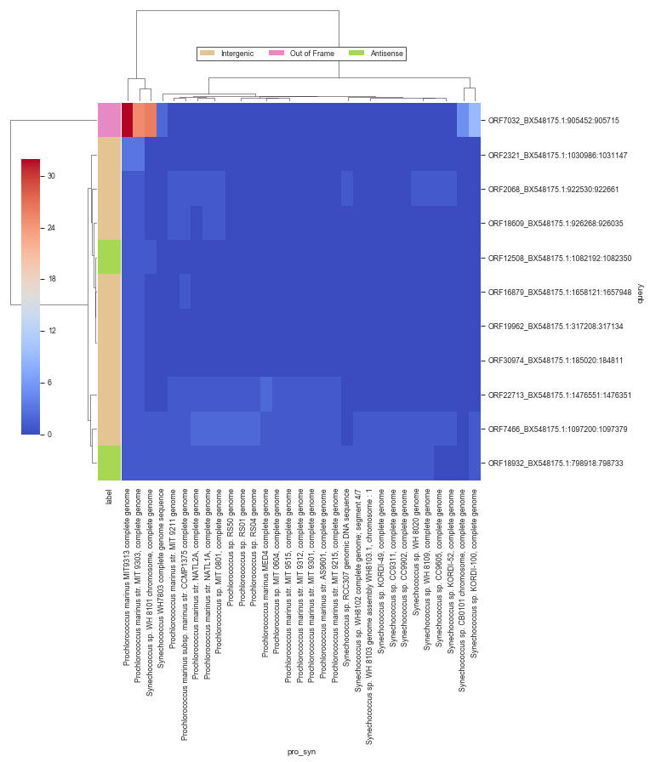
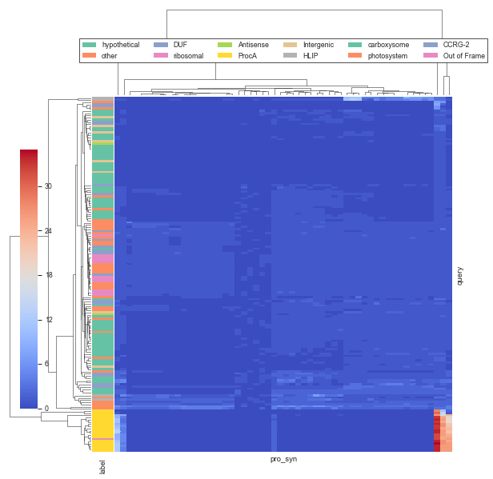

Slide 4
MIT9313 alternative ORFs from proteome ISME16

Slide 5
Goal
Detect small proteins (< 100 aa) in PRO genomes
already annotated
newly discovered
Identify small proteins involved in interaction with heterotrophic bacteria

Slide 6
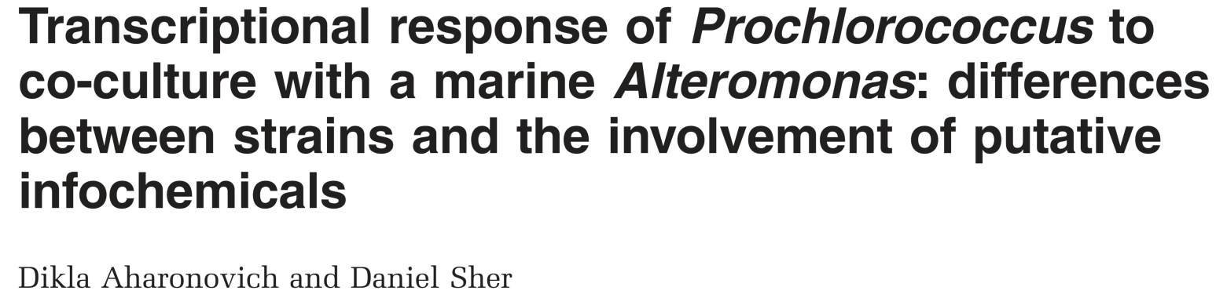
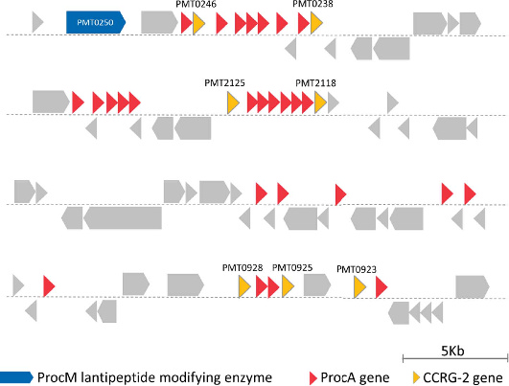
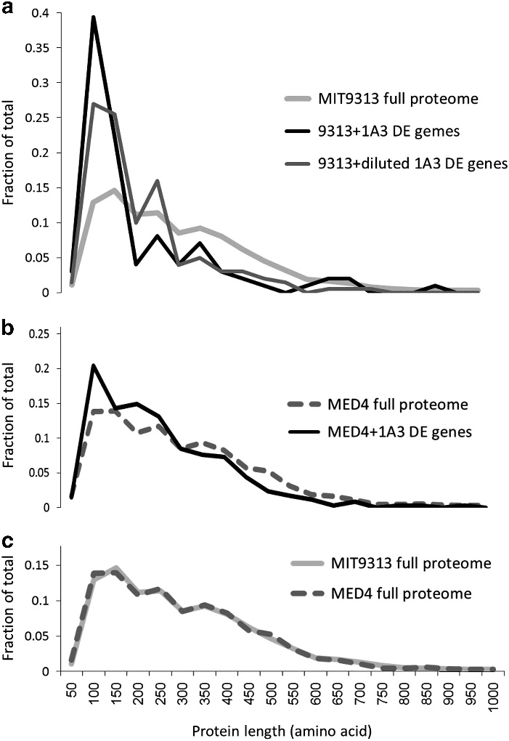
Motivation
Dikla’s ISME16 paper
Gene expression of co-culture enriched for small proteins
New family of short genes: CCRG-2 (co-culture responsive genes)
Sequence motif involved in the export of prochlorosins and other
bacteriocin-like peptides
Released from the cells into the media.

Slide 7
Main techniques for novel small genes identification
Proteomics
Working with David (Weizmann) to do directed proteomics with filtering of small peptides
Starting with analysis of proteomics DB from Dikla’s 2016 paper
RIBO-SEQ
Detect mRNA undergoing translation (connected to ribosomes)
bio-informatics
Look for small ORFs, detect similarities to protein coding genes

Slide 8
Proteomics analysis so far
All alternative ORFs in MIT9313 genome 6 frame translation
34503 total ORFs
Detect in proteomics
Unique Peptides > 1 or max_xCorr > 3
1358 detected
Select < 100 aa
180 selected
including 2386 annotated genes

Slide 9
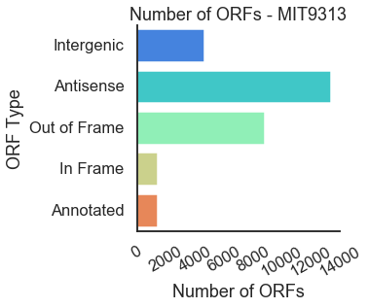
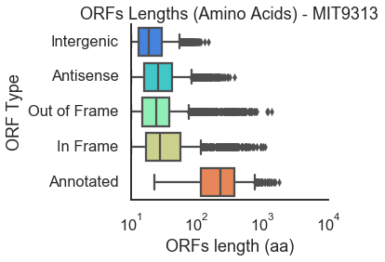
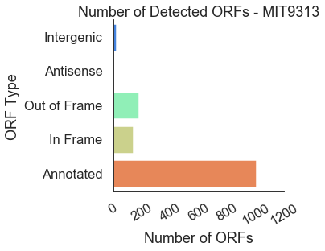
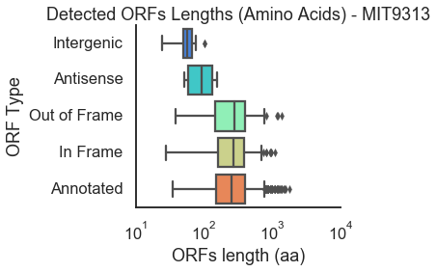
putative
detected

Slide 10
Detected small proteins
Family | Annotated | Antisense | Intergenic | Out of Frame | Total
Intergenic |  |  | 11 |  | 11
ProcA | 18 |  |  | 1 | 19
CCRG-1 | 1 |  |  |  | 1
CCRG-2 | 2 |  |  |  | 2
HLIP | 3 |  |  | 1 | 4
Carboxysome | 2 |  |  |  | 2
Photosystem | 6 |  |  |  | 6
Ribosomal | 11 |  |  | 1 | 12
DUF | 14 |  |  | 3 | 17
Hypothetical | 54 | 2 |  | 9 | 65
Other | 23 |  |  | 7 | 30
Total | 134 | 2 | 11 | 22 | 169

Slide 11
Clustering of detected proteins (by blast)
Cluster id | Family |  | Product | Total
1 | ProcA | 18 | Nif11-like leader peptide family natural product precursor | 19
 | ProcA | 1 | Lantipeptide
2 | Intergenic | 1 |  | 2
 | Hypothetical | 1 | hypothetical protein
3 | HLIP | 4 | high light inducible protein | 5
 |  | 1 | ssl1498 family light-harvesting-like protein
4 | Hypothetical | 2 | hypothetical protein | 2
5 | Hypothetical | 2 | hypothetical protein | 2
6 | Hypothetical | 2 | hypothetical protein | 2
7 | Hypothetical | 2 | hypothetical protein | 2
8 | Hypothetical | 1 | hypothetical protein | 2
 |  | 1 | RNA recognition motif-containing protein
9 | CCRG-2 | 1 | CCRG-2 family RiPP | 3
 | CCRG-2 | 1 | hypothetical protein (CCRG-2)
 |  | 1 | bacteriocin
10 | Carboxysome | 1 | carboxysome peptide A | 2
 | Carboxysome | 1 | carboxysome peptide B

Slide 12
Detected Small proteins – not in any cluster
Product
2Fe-2S iron-sulfur cluster binding domain-containing protein
rubredoxin
sulfur carrier protein ThiS
NifU family protein
BolA family transcriptional regulator
response regulator transcription factor
transcriptional repressor
NAD(P)H-quinone oxidoreductase subunit O
CopG family transcriptional regulator
4a-hydroxytetrahydrobiopterin dehydratase
NAD(P)-dependent oxidoreductase
translation initiation factor IF-1
Asp-tRNA(Asn)/Glu-tRNA(Gln) amidotransferase subunit GatC
pterin-4-alpha-carbinolamine dehydratase
glutaredoxin 3
PipX family protein
16S rRNA (cytidine(1402)-2'-O)-methyltransferase
Pr2TM family membrane protein
HU family DNA-binding protein
YciI family protein
ATP-dependent Clp protease adapter ClpS
FADH(2)-oxidizing methylenetetrahydrofolate--tRNA-(uracil(54)-C(5))- methyltransferase TrmFO
chlororespiratory reduction protein 7
chemotaxis protein
cupin domain-containing protein
YlxR family protein
Family | Product
CCRG-1 | guanylate-binding protein
Photosystem | photosystem I iron-sulfur center protein PsaC
 | photosystem I reaction center subunit IV
 | photosystem I reaction center subunit PsaK
 | photosystem II reaction center protein J
 | photosystem II reaction center protein L
 | photosystem II reaction center protein PsbH
Ribosomal | 30S ribosomal protein S13
 | 30S ribosomal protein S15
 | 30S ribosomal protein S17
 | 30S ribosomal protein S18
 | 30S ribosomal protein S19
 | 30S ribosomal protein S21
 | 50S ribosomal protein L27
 | 50S ribosomal protein L28
 | 50S ribosomal protein L29
 | 50S ribosomal protein L31
 | 50S ribosomal protein L32
 | 50S ribosomal protein L33
Family | Product
Intergenic |  | 10
hypothetical | hypothetical protein | 55
DUF | DUF4278 domain-containing protein | 2
 | DUF1816 domain-containing protein
 | DUF1995 family protein
 | DUF2470 domain-containing protein
 | DUF2555 domain-containing protein
 | DUF2862 domain-containing protein
 | DUF2949 domain-containing protein
 | DUF2973 domain-containing protein
 | DUF2996 domain-containing protein
 | DUF3136 domain-containing protein
 | DUF3148 domain-containing protein
 | DUF3181 family protein
 | DUF3252 domain-containing protein
 | DUF3303 family protein
 | DUF3721 domain-containing protein
 | DUF3764 family protein

Slide 13
Intergenic ORFs
orfid | mit9313 alignments | pro/syn genomes | mean pro/syn alignments | pro_syn_description | e | coverage | identity | Cluster id
ORF2068_BX548175.1:922530:922661 | 1 | 11 | 1 | gb|ABM78103.1| Hypothetical protein P9303_13561 [Prochlorococcus marinus str. MIT 9303] | 1.00E-20 | 1.00 | 0.90
ORF2321_BX548175.1:1030986:1031147 | 3 | 1 | 3 | gb|KZR65522.1| hypothetical protein PMIT1306_00434 [Prochlorococcus sp. MIT 1306] >gb|KZR65553.1... | 5.00E-32 | 1.00 | 1.00 | 2
ORF7466_BX548175.1:1097200:1097379 | 1 | 28 | 1 | ref|WP_011825714.1| unnamed protein product >gb|ABM77811.1| Conserved hypothetical protein [Proc... | 2.00E-39 | 1.00 | 1.00
ORF13811_BX548175.1:1709954:1710130 | 1 | 33 | 1 | ref|WP_011824978.1| hypothetical protein [Prochlorococcus marinus] >gb|ABM77051.1| membrane prot... | 2.00E-33 | 1.00 | 1.00
ORF16879_BX548175.1:1658121:1657948 | 1 | 2 | 1 | emb|CAX32265.1| Conserved hypothetical protein [Prochlorococcus marinus str. MIT 9313] | 4.00E-36 | 1.00 | 1.00
ORF18609_BX548175.1:926268:926035 | 1 | 5 | 1 | gb|KGG27689.1| hypothetical protein EV12_1119 [Prochlorococcus sp. MIT 0701] >gb|KGG31928.1| hyp... | 5.00E-26 | 0.80 | 0.60
ORF19962_BX548175.1:317208:317134 | 1 | 1 | 1 | emb|CAE20454.1| hypothetical [Prochlorococcus marinus str. MIT 9313] | 2.00E-10 | 1.00 | 1.00
ORF22713_BX548175.1:1476551:1476351 | 1 | 16 | 1 | emb|CAX32212.1| Conserved hypothetical protein [Prochlorococcus marinus str. MIT 9313] | 8.00E-43 | 1.00 | 1.00
ORF30023_BX548175.1:644083:643928 | 1 | 32 | 1 | ref|WP_011129965.1| MULTISPECIES: hypothetical protein [Synechococcales] >gb|ABM78406.1| conserv... | 1.00E-28 | 1.00 | 1.00
ORF30529_BX548175.1:408367:408233 | 1 | 19 | 1 | ref|WP_011129739.1| MULTISPECIES: hypothetical protein [Prochlorococcus] >gb|NMO84559.1| hypothe... | 3.00E-26 | 1.00 | 1.00
ORF30974_BX548175.1:185020:184811 | 1 | 1 | 1 | emb|CAX31811.1| Conserved hypothetical protein [Prochlorococcus marinus str. MIT 9313] | 5.00E-45 | 1.00 | 1.00

Slide 14
Out of Frame with swisprot match
family2 | pro/syn genomes | mean pro/syn alignments | product | swis_description | swis_e | swis_coverage | swis_identity
other | 51 | 1 | transcriptional repressor | Ferric uptake regulation protein; Short=Ferric uptake regulator [Synechococcus elongatus PCC 7942 = FACHB-805] | 2.00E-14 | 0.90 | 0.40
HLIP | 54 | 2 | high light inducible protein | Uncharacterized protein ycf17; AltName: Full=ORF48 [Cyanophora paradoxa] | 5.00E-07 | 0.60 | 0.30
ribosomal | 66 | 1 | 30S ribosomal protein S13 | 30S ribosomal protein S13 [Synechococcus sp. CC9311] | 8.00E-26 | 1.00 | 1.00

Slide 15
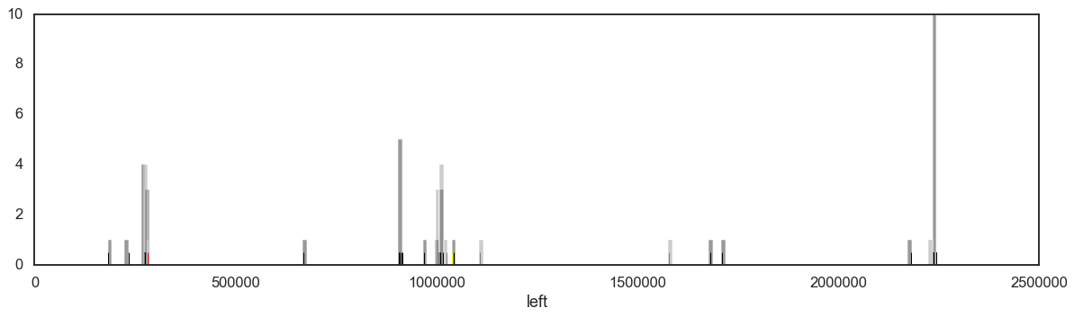
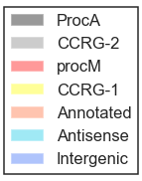
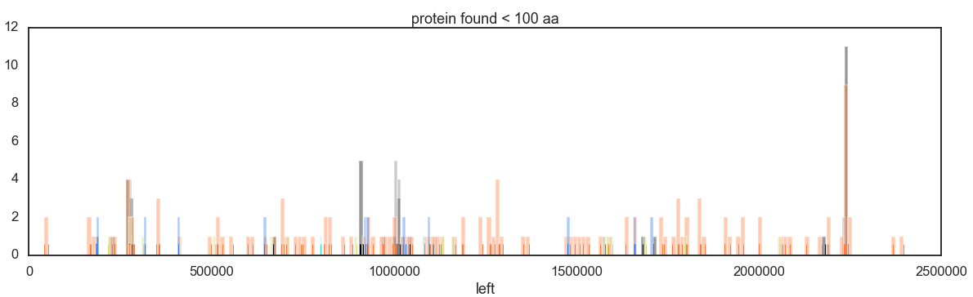

Slide 16
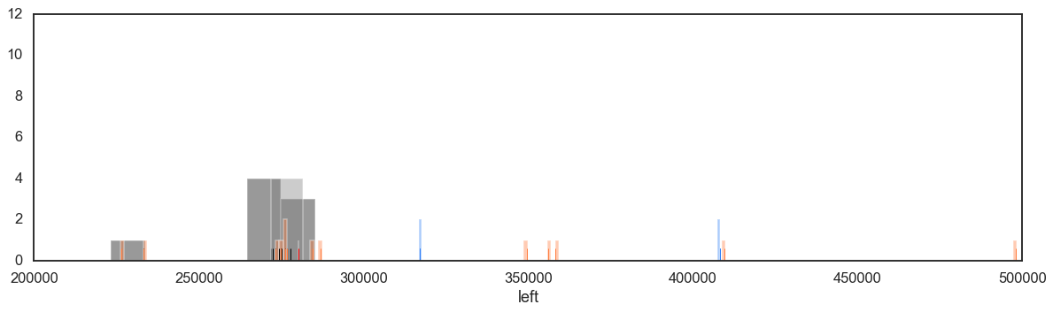
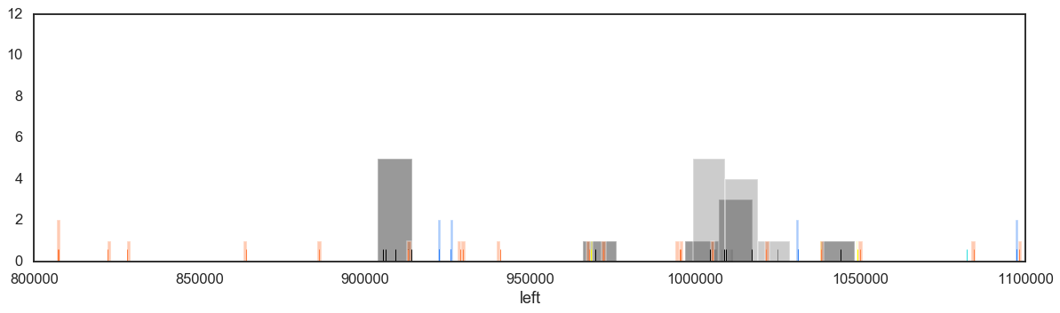
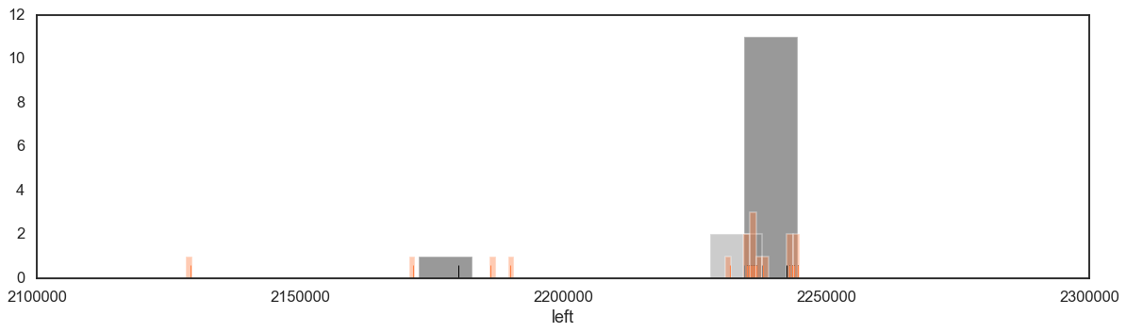
Zoom in

